Slide 1



DATA ANALYSIS AND DECISION MAKING – CMS MEDICARE PROJECT

Slide 2


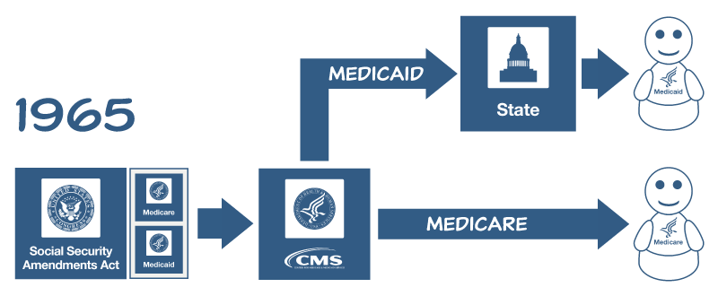
It’s a Federal agency of United States department of Health and Human resources.
It was created in 1965 by President Lyndon Johnson for the older and low income group.
Federal and State government work in collaboration
Medicare: Beneficiaries are 65 and older, disabled less then 65, patients with ESRD

Slide 3

PHYSICIAN WOES
Health care reforms, rise of hospital networks and Baby-Boomers are complicating lives of doctors.
From Physician’s perspective: Region/State, Specialty/Sub-specialty.
From CMS perspective: Maximum expected reimbursement claims.

Slide 4
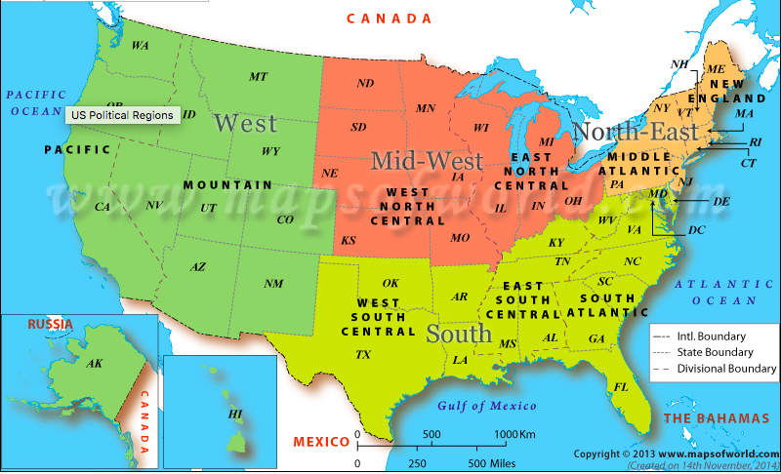
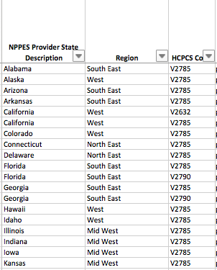
DATA CONSOLIDATION AND SORTING
File Number 1:
Name-Medicare_State_HCPCS_Aggregate_CY2014.xlsx
(Referred to as the ‘HCPCS’ table hereafter)
Alterations in the HCPCS table:
Region added
The US map was split into 4 regions – Northeast, Southeast, Mid West and West- (Refer picture on top left)
The NPPES state codes were mapped to their respective regions.
Easier to Visualize and Analyze the data.
Only the US records were considered
Since HCPCS codes and Descriptions are numerous and analysis is difficult, the HCPCS codes were broken down into their major category.
This would make analysis easier and better to visualize.
The HCPCS description column was also removed.

Slide 5
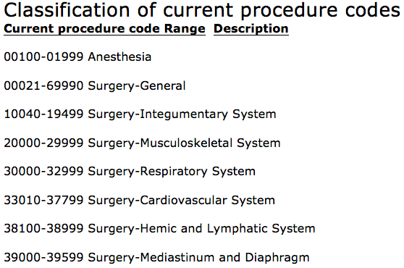
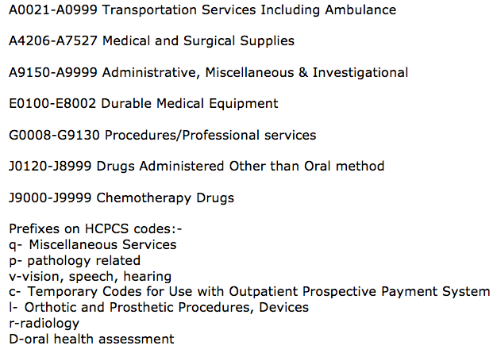
DATA CONSOLIDATION AND SORTING
Breaking Down the HCPCS codes
The HCPCS codes were broken down and categorized into their appropriate major procedure.
The picture on the right shows how the codes were mapped.
The HCPCS codes had prefixes and suffixes also, which meant what category of medical procedure they belonged to.
Mapping the HCPCS codes
Will save time
Reading through the entire description is not a feasible option.
The ‘General’ column will have all the major categories, approximately 15-20, so it will be easier to visualize or present it in an understandable manner.

Slide 6
DATA CONSOLIDATION AND SORTING
File Number 2:
Name-Medicare_Physician_and_Other_Supplier_National_Provider_Identifier__NPI__Aggregate_Report__Calendar_Year_2014
(Referred to as the ‘Supplier’ table hereafter)
Alterations in the Supplier table:
First name, last name, middle initial removed.
City, street address, zip code removed.
Drug suppress indicator and medical suppress indicator removed.
Derived columns can be eliminated if needed.
Example:- Total Medicare Payment Amount=Total Drug Payment Amount + Total Medical payment Amounts; Similarly for other submitted and allowed amounts.
Only US records were considered.
The file was reduced to about 100,000 records for visualizations using stattools. (Reduced by sampling 1 out of every 10 records, to ensure no vital information is lost)
Region added

Slide 7
UNDERLYING QUESTIONS
Breaking Down the Objectives
PROVIDERS
Gender, Place of Service, Number of procedures, Location, Number of Beneficiaries, etc.
MEDICARE PATIENTS
Procedure, Age, Race etc.
MEDICARE PROCEDURES
Average cost per region, Allowed amount per procedure, Number of services per procedure etc..

Slide 8
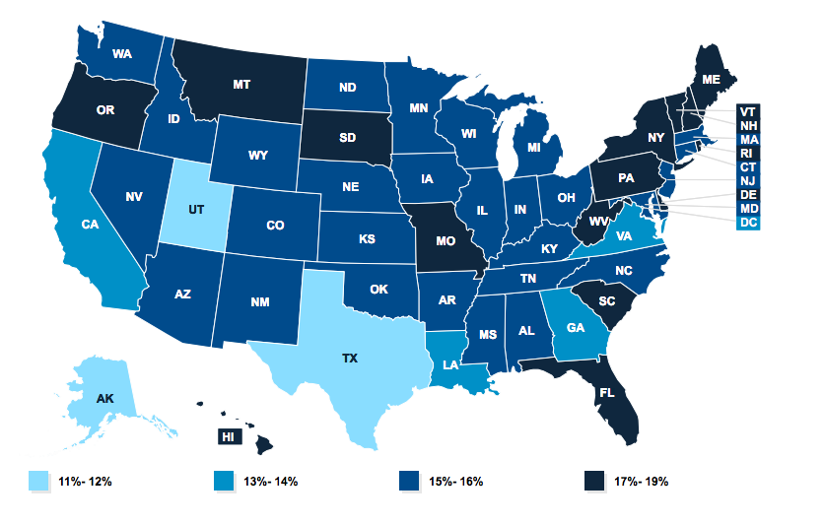
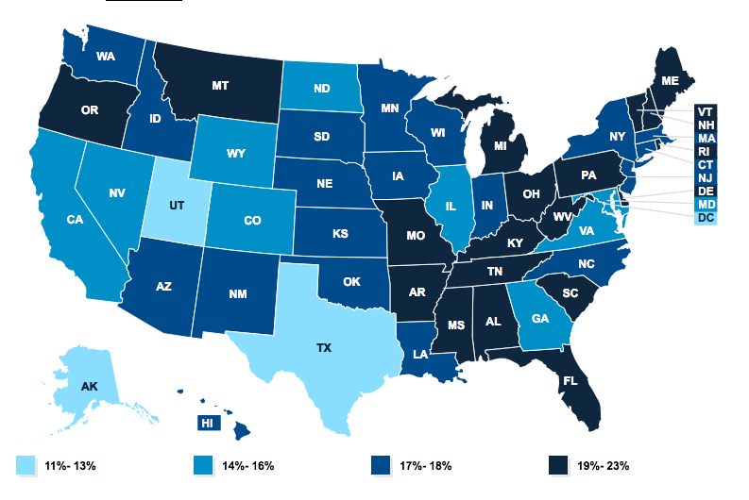
BENEFICIARIES VS. TOTAL POPULATION
The map(left) shows the percentage of population benefited by medicare compared to the total US population.
The total population represented is of the year 2014.
INFERENCE:
From a Medicare Supplier’s Perspective, It is beneficial for a medicare supplier to be in either the NE or SE region.
From CMS perspective, it should expect more medicare submissions or claims from NE, SE regions.
The map(right) shows the total percentage of people of ages 65+ compared to the total US population.
It is observed that the majority percentage of people from that age group are also from the NE and SE region.
Therefore, it is very evident that the percentage of beneficiaries are high because of the high percentage of population with ages above 65.

Slide 9
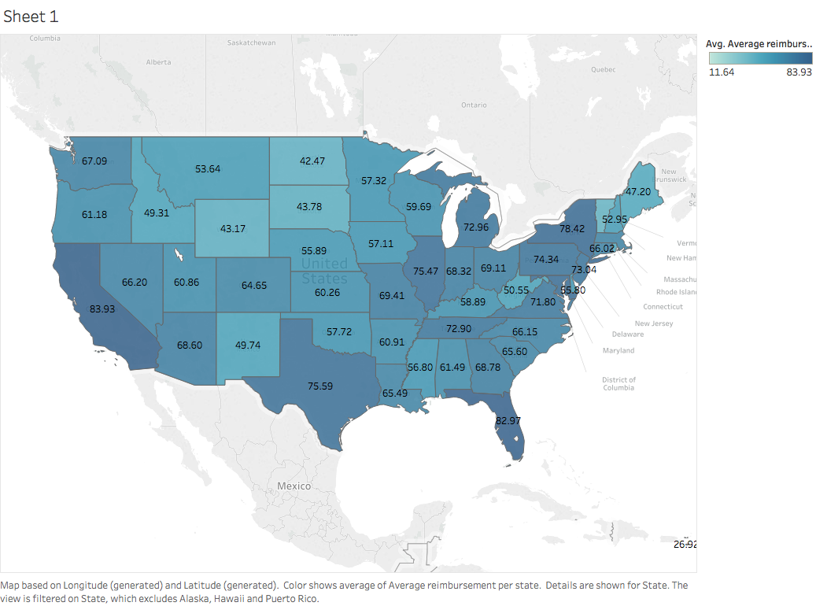
AVERAGE REIMBURSEMENT PER STATE
The map(right) shows the average reimbursement per state.
Formula:
Reimbursement per Supplier= Average Medicare Allowed Amount Of Supplier – Average Medicare Payment Amount Of Supplier
Reimbursement per State= Sum(Reimbursement Per Supplier)Of All Suppliers/ Number of Suppliers In The State
INFERENCE:
The higher the number means, high gap between Allowed amount and Repayment amount.
States where the difference (value shown in picture) is low, the medicare will cover a good amount of the submitted claim.
California, Texas, New York, Florida have high gap.

Slide 10
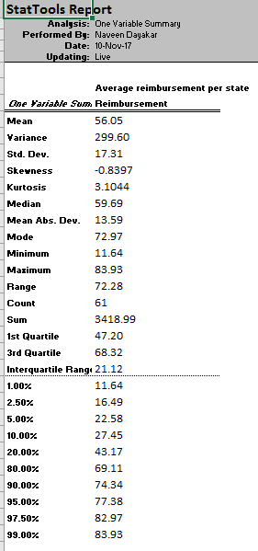
SUMMARY STATISTICS FOR THE AVERAGE REIMBURSEMENT
The figure(right) shows the summary stats of the reimbursement difference.
Formula:
Reimbursement per Supplier= Average Medicare Allowed Amount Of Supplier – Average Medicare Payment Amount Of Supplier
Reimbursement per State= Sum(Reimbursement Per Supplier)Of All Suppliers/ Number of Suppliers In The State
It is easier to visualize the minimum, maximum , variance, standard deviation values.
INFERENCE:
Mode gives an idea of the most frequent/ repeating value. States which have values near the mode, have moderate repayment rates.
States which have value near the Minimum, CMS will cover a good portion of the submitted claim.

Slide 11
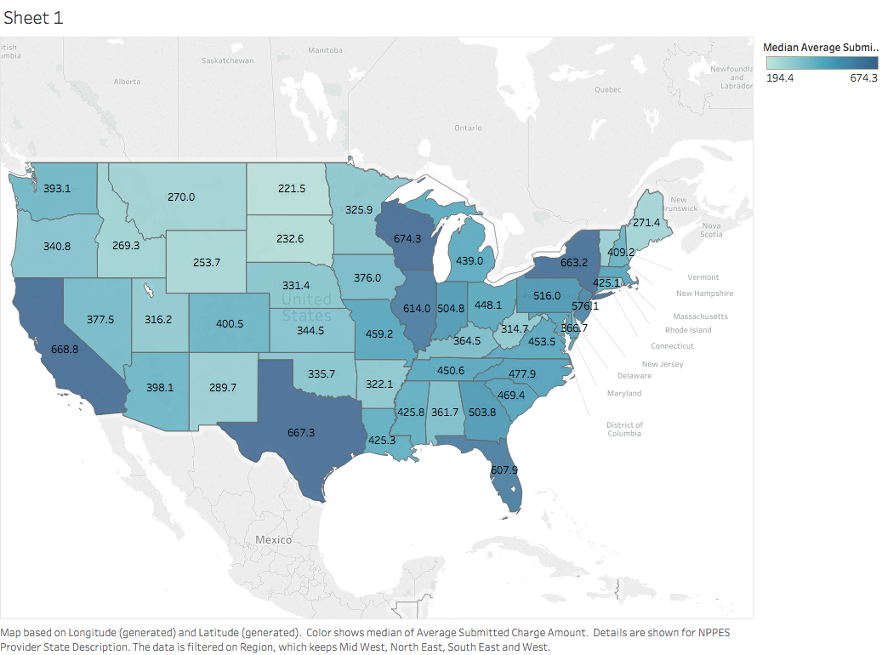
AVERAGE SUBMITTED AMOUNT PER STATE
The map(right) shows the average submitted amount per state.
Formula:
Median Submitted Amount= Median of (Total Submitted Amount Per Supplier)Of All Suppliers/ Number of Suppliers In The State
INFERENCE:
The higher the number, it means that each supplier in that particular state submits an high value to the CMS for medicare repayment.
States where the number is low, the medicare may possibly cover a good amount of the submitted claim for all suppliers.
RELATION TO THE REIMBURSEMENT GRAPH:
The probability of reimbursement of submitted amount is low for the same states where the median submitted amount is high.
If all the suppliers in a particular state have high average submitted amount, CMS cannot repay them back as good as the other states.

Slide 12
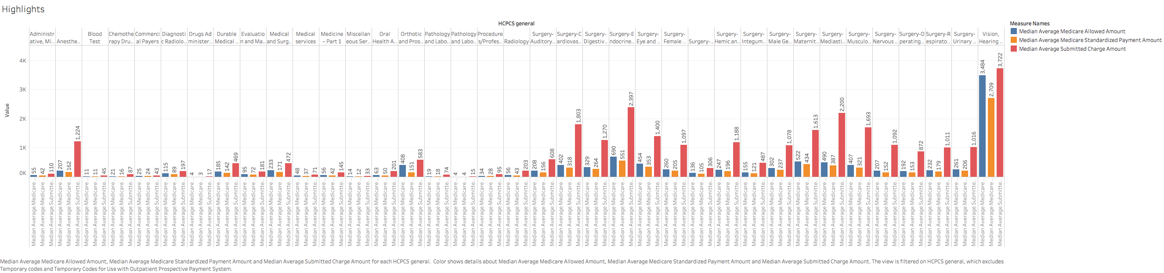
COSTLIEST PROCEDURES FOR MEDICARE CLAIMS
The graph shows the median values of
Medicare Allowed Amount
Medicare Standardized Payment Amount
Medicare Submitted Charge Amount
The Graph gives an idea of :-
How much the procedures from that General category cost,
The average claim submitted that CMS can expect, and
The repayment the medicare supplier(physician/Hospital) can expect.

Slide 13
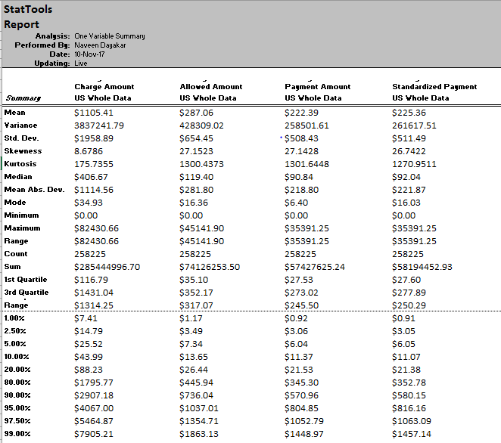
COSTLIEST PROCEDURES FOR MEDICARE CLAIMS
The Summary stats is easy to interpret .
The stats show the variance, standard deviation, minimum and maximum for all the types of amounts.
The stats represent data for records only from the US.

Slide 14
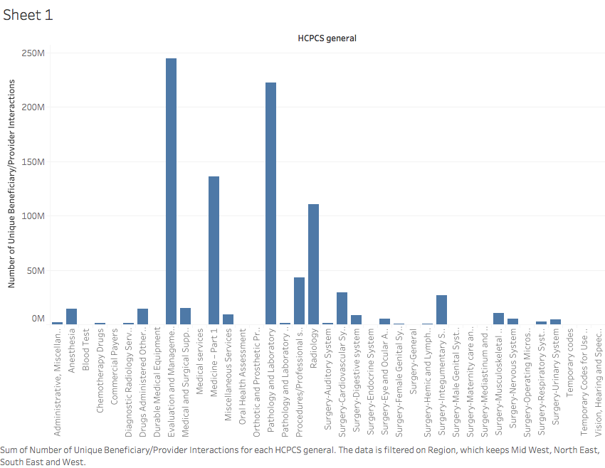
UNIQUE BENEFICIARIES PER PROVIDER vs PROCEDURE
The graph shows the total number of unique beneficiaries per provider(physician/ Hospital).
This shows the highest number of beneficiaries for the Evaluation and Management Category.
Followed by Pathology and Laboratory, Medicine, Radiology.
INFERENCE:-
The Evaluation and Management Category is high because it tracks the inpatient visits, and most of the patients are involved in it.
Medicine part-1 involves vaccines ,Pathology and Laboratory involves all the blood tests and other lab activities. So, these categories also have high number of beneficiaries.

Slide 15
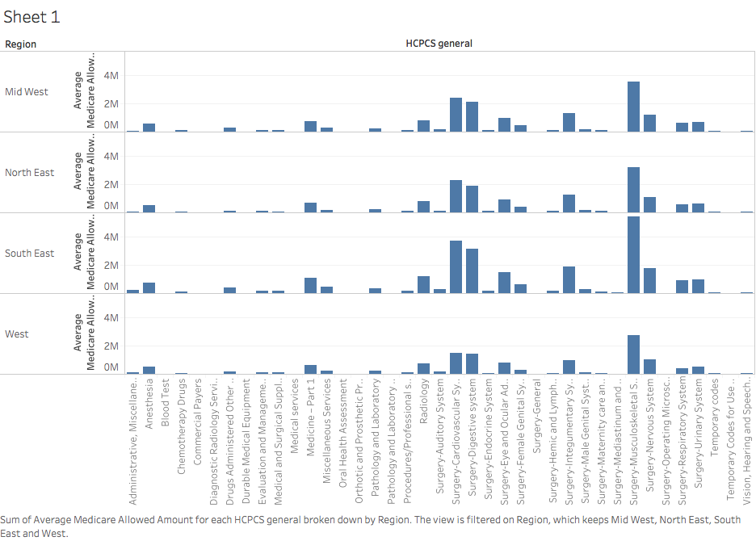
TOTAL ALLOWED AMOUNT PER REGION
The graph(right) shows the Total Allowed Amount for all procedures in a General medical category.
NOTE:-
ONLY DISTINCT HCPCS CODES WERE CONSIDERED PER REGION
INFERENCE:
The values are not the same for each region.
It means that, the same set of procedures have a higher allowed amount on a particular region.
This means that there is a bias with respect to region.
CMS has set the allowed amount for a set of procedures depending on the region where they are performed.

Slide 16
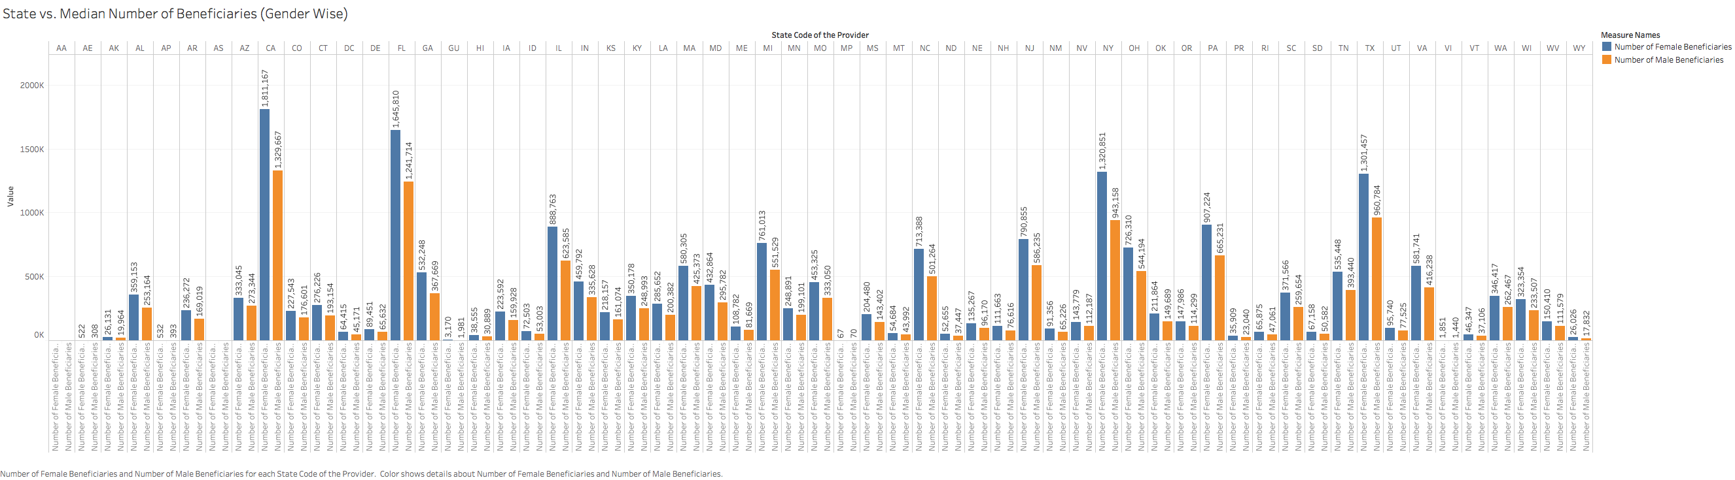
NUMBER OF BENEFICIARIES PER STATE
The graph shows the Number of Male and Female beneficiaries from each state.
Inference:
In most of the cases, the number of female beneficiaries are more than the number of male beneficiaries.

Slide 17
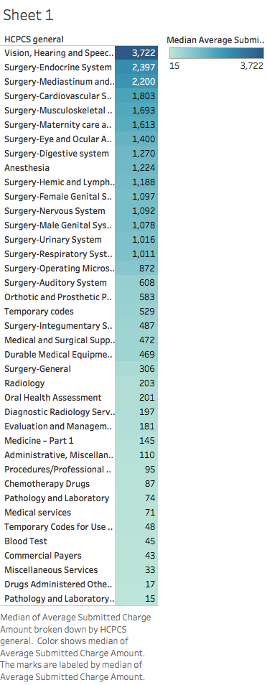
SUBMITTED AMOUNT vs PROCEDURES
The graph(right) shows the Median Submitted Charge Amount for all procedures in a General medical category.
The median will give us the exact amount that is being submitted to CMS for repayment for that particular general category.
Median gives more accurate value than average in this particular case.
INFERENCE:
It is clearly visible that the Surgery Category has high submitted charge amount.
Vision, hearing and Speech Category involves procedures that include transporting, preserving and operating delicate organs like the Eye. Hence, the high charge involved and submitted charge.

Slide 18
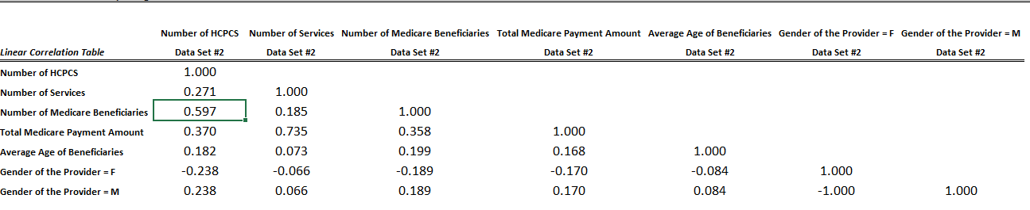
CORRELATION – INDIVIDUAL PROVIDERS
The picture shows the correlation between variables- NE region is taken for this analysis.
INFERENCE:
The Number of HCPCS vs Number of Medicare Beneficiaries have high correlation.
The highest correlation is between Number of Services and Total Medicare Payment Amount.
Very less correlation between Number of services vs Number of Medicare Beneficiaries

Slide 19
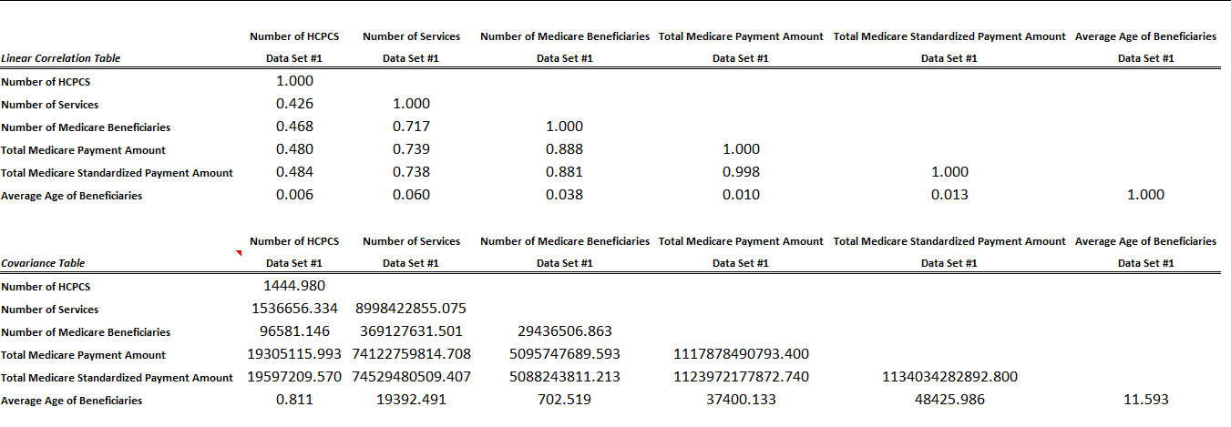
CORRELATION – ORGANIZATION PROVIDERS
The picture shows the correlation between variables- NE region is taken for this analysis.
OBSERVATIONS:
High correlation between Number of services and
Number of medicare beneficiaries, Total medicare payment amount, Total Medicare Standardized payment amount
Very high correlation between Number of medicare beneficiaries and
Total medicare payment amount, Total Medicare Standardized payment amount.
INFERENCE:
So, the number of services provided has a high correlation to the number of medicare beneficiaries,
Which in turn results in high medicare payment and standardized payments.
For the individuals, the number of services did not influence the number of medicare beneficiaries by any chance.

Slide 20
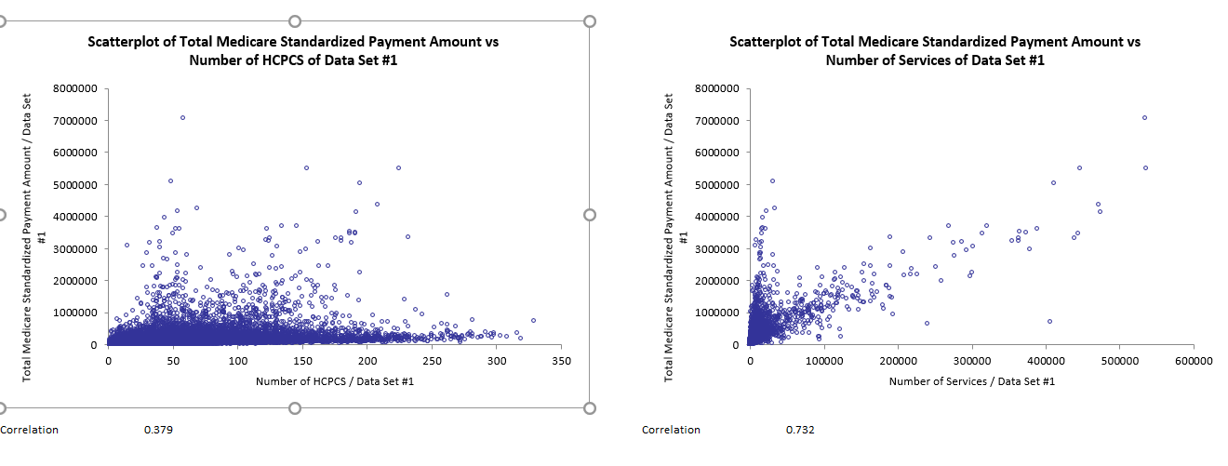
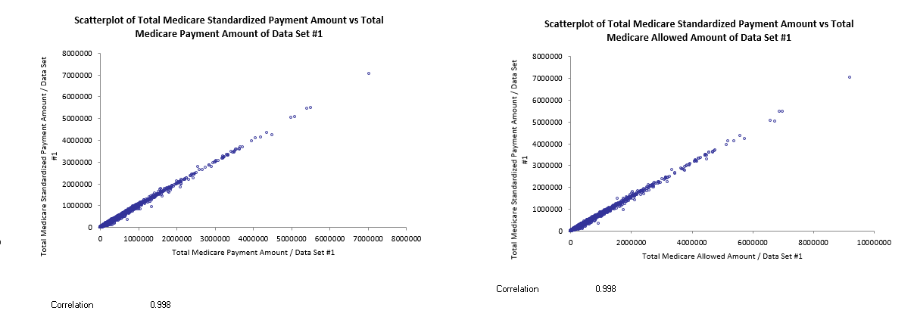
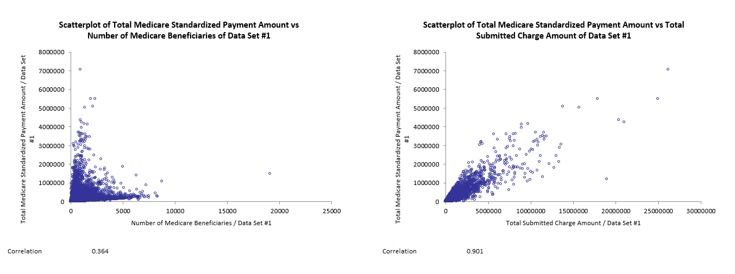
SCATTERPLOT FOR CORRELATION- INDIVIDUAL PROVIDERS
The correlation between the variables can be represented by scatterplot also.
Visually, the correlation is more evident between the variables.
Only Individual providers from the SE region were considered.

Slide 21
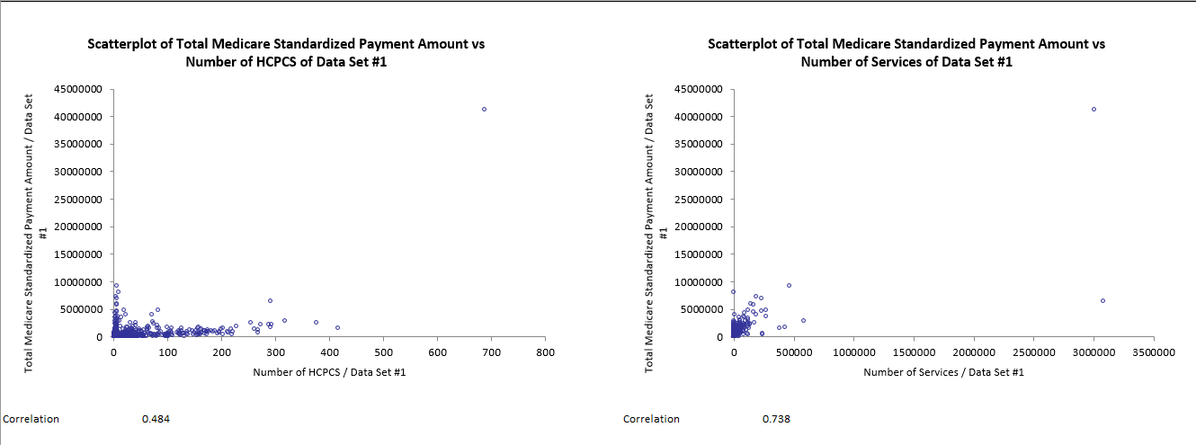
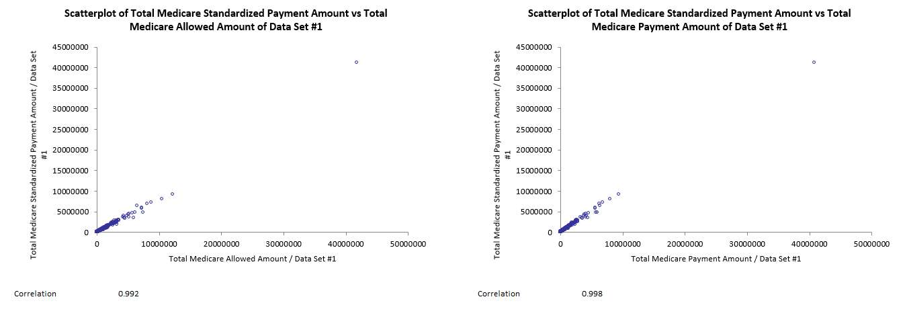
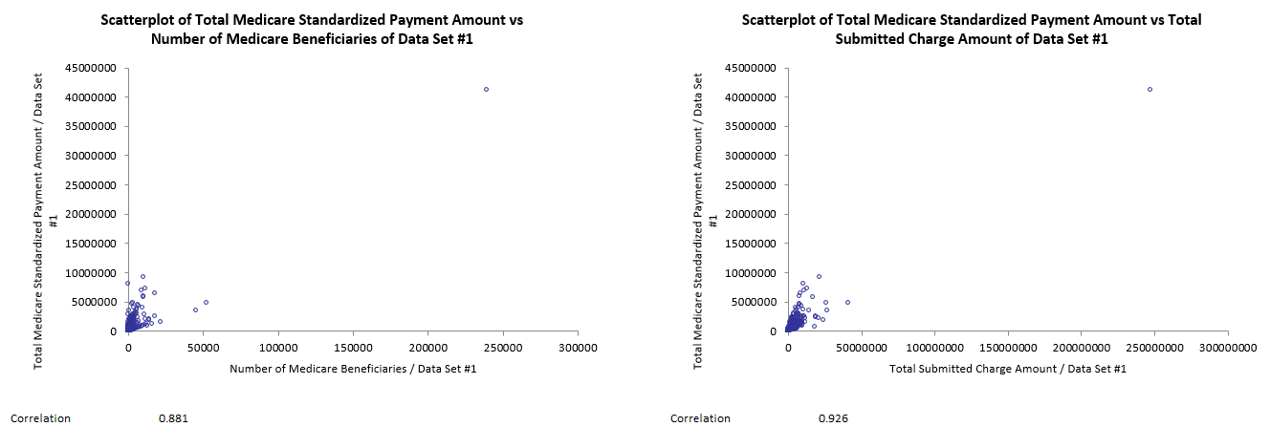
SCATTERPLOT FOR CORRELATION- ORGANIZATION PROVIDERS
Only Organization providers from the SE region were considered.
Visually the correlation is more evident between the variables.
Less number of instances available than Individual Providers.
The correlation for payment amounts is almost same as for individual providers.

Slide 22
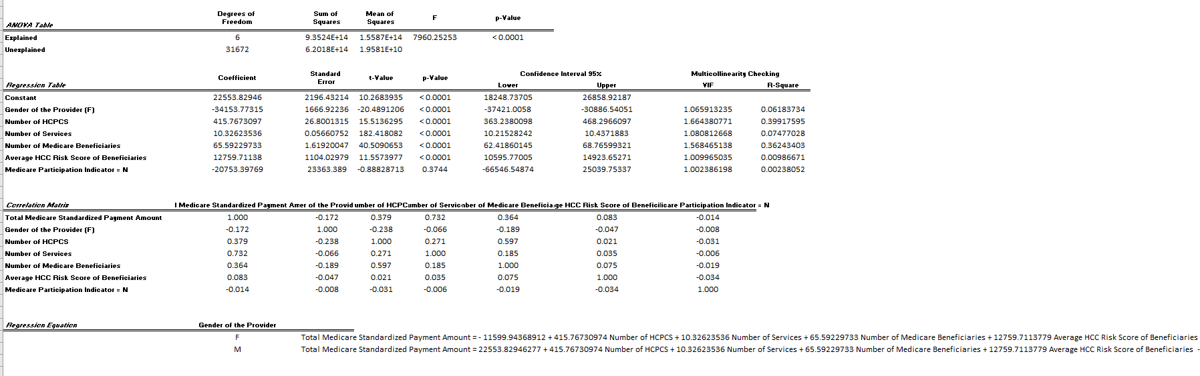
MULTIPLE REGRESSION- INDIVIDIAL PROVIDERS
The picture shows the multiple regression between variables- SE region is taken for this analysis.
OBSERVATIONS:
The P-value of all the variables are very low.
The regression equation shows that the coefficients of all the variables are exactly same for both male and female providers.
But, there is a higher intercept for the male providers than female providers for the total medicare standardized payment amount.
INFERENCE:
The reason for the higher intercept, can be because of 1)higher number of male providers or;
2)Higher number of services provided by the male providers.

Slide 23
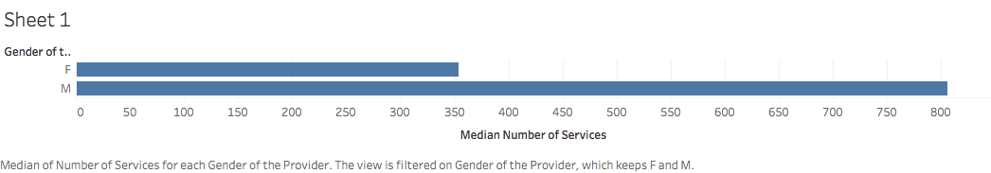
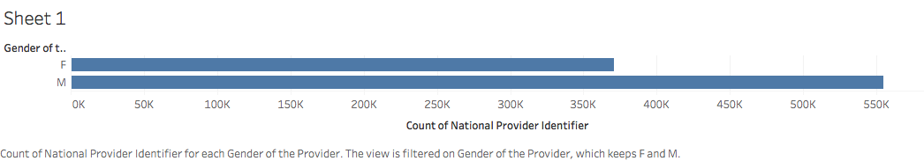
ANALYSIS ON MALE AND FEMALE PROVIDERS
First graph shows the median number of services by Male and Female Providers
Second graph shows the total number of Male and Female providers
INFERENCE:
Male providers have more median number of services.
Male Providers are more in number.
Thus, the intercept is high in regression equation for payment amount. No Bias for Gender.

Slide 24
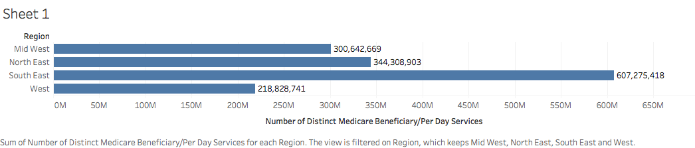
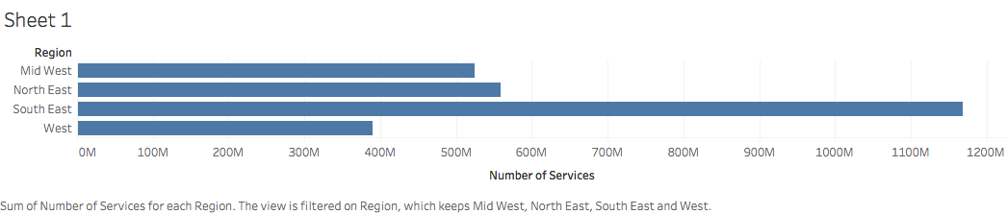
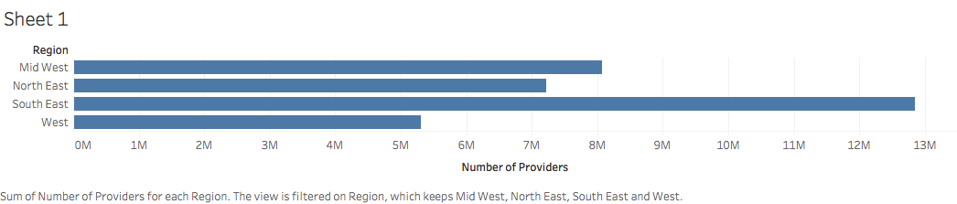
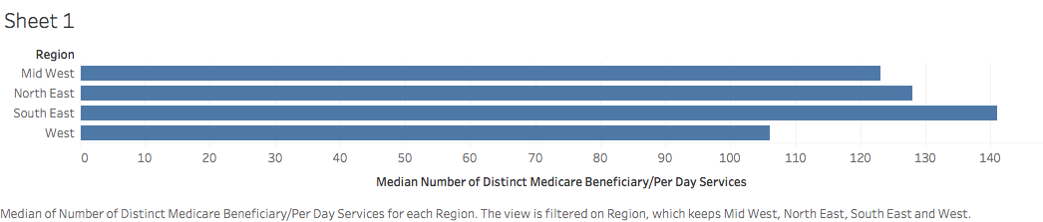
ANALYSIS ON NUMBER OF SERVICES
Total Distinct Beneficiaries per Day services (Region Wise)
SE region has high value.
Total Number of services (Region Wise)
SE region has high value.
Number of Providers per Region (Region Wise)
SE region has high value.
Median Distinct Beneficiaries per day Services (Region Wise)
SE region is high.

Slide 25
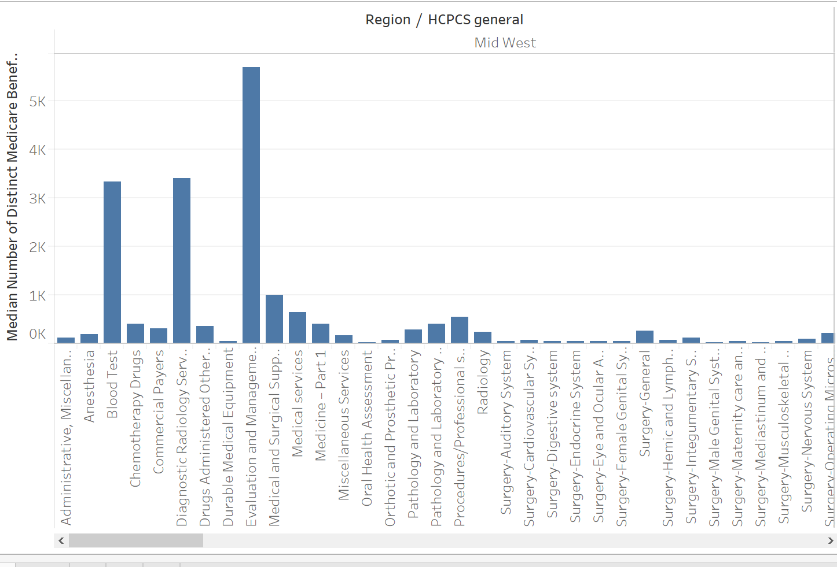
DISTINCT MEDICARE BENEFICIARIES vs SPECIALIZATION
Data showing the relation between the Median Number of distinct beneficiaries and HCPCS general
Median Number of Distinct Medicare Beneficiaries- A single patient having multiple number of services ( like ED visits, New patient services)
Evaluation and Management - If a single patient have different number of services in a single admission, providers lists it under E & M during the reimbursement of Medicare amounts.

Slide 26
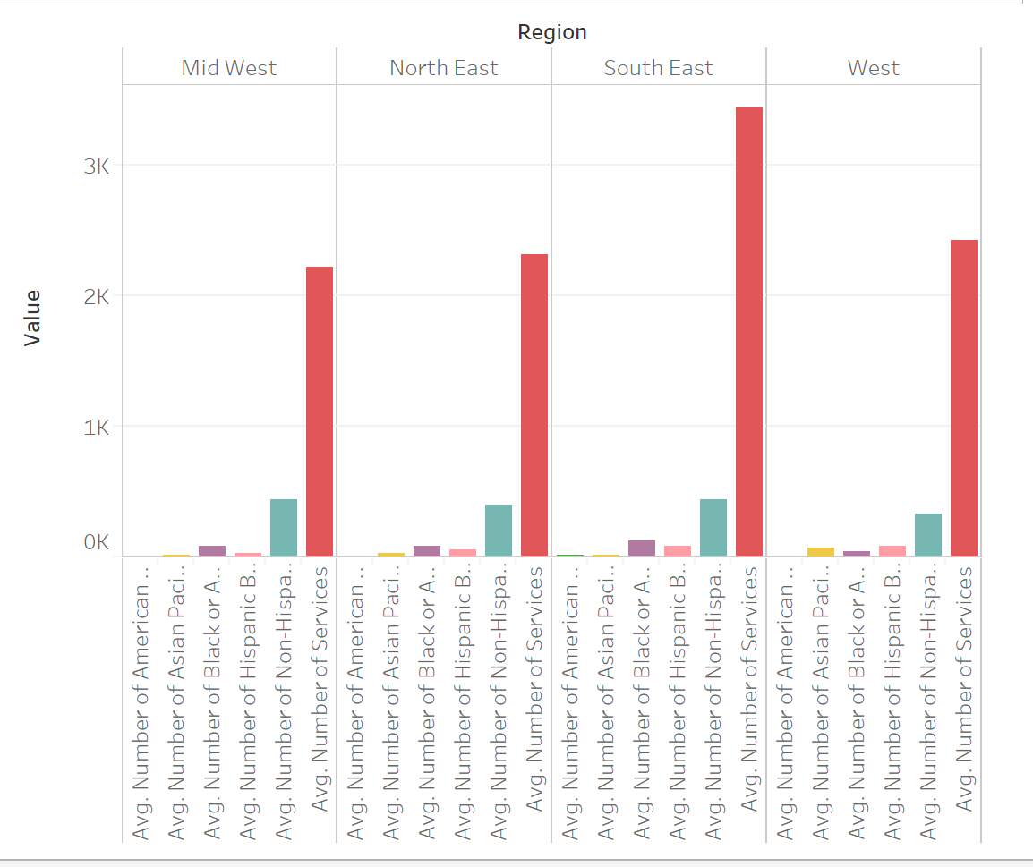
AVERAGE NUMBER OF BENEFICIARIES PER RACE
The graph shows the percentage of individuals from each race, benefited by medicare per provider.
Non-Hispanic category is more in all the regions.
On an average, the providers have more number of medicare beneficiaries in the Non-Hispanic Population.

Slide 27
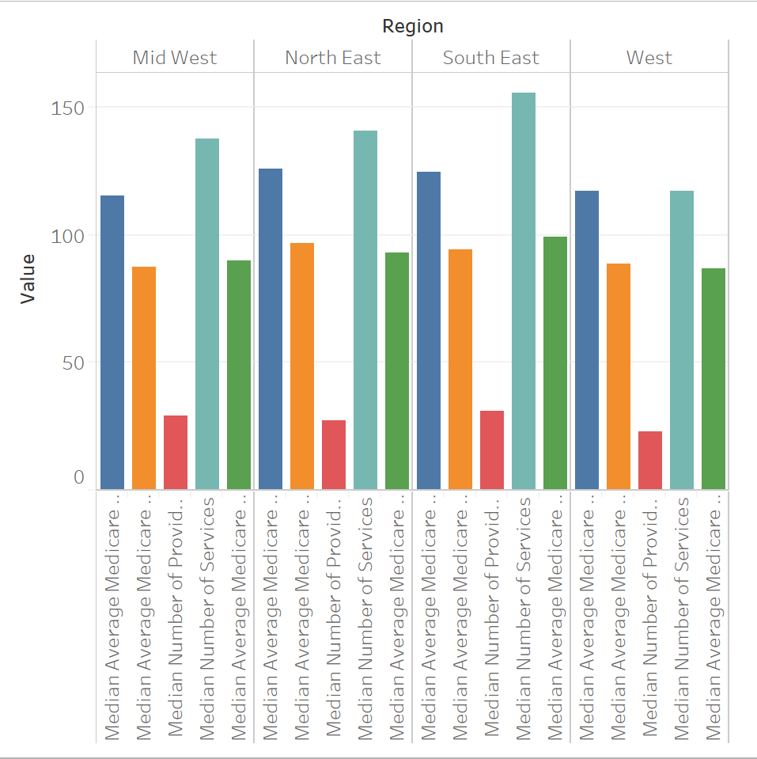
REGION WISE ANALYSIS ON PAYMENTS AND SERVICES PROVIDED
Blue - Median Average Allowed Amount (Mid west- 115.3, North East -126.1)
Orange - Median Average Medicare Payment Amount ( MW- 86.5, NE- 96.6)
Red - Median number of providers ( MW - 29, NE- 27)
Amazonite - Median Number of Services ( MW- 138, NE- 141)
Green- Median Average Medicare Standardized Payment Amount (MW- 90, NE- 93.1)

Slide 28
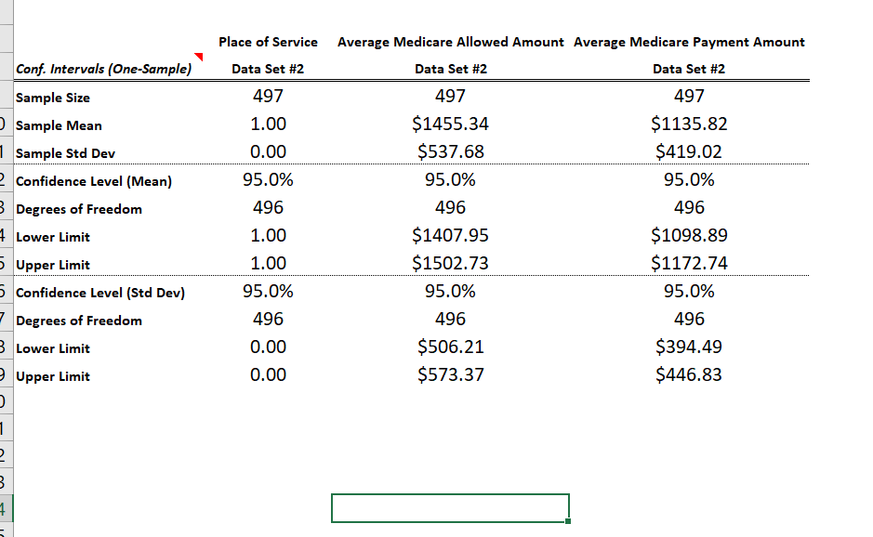
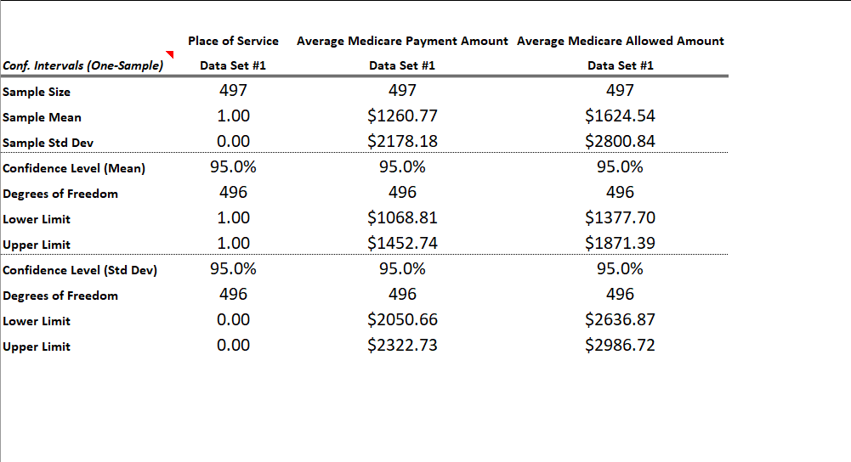
CONFIDENCE INTERVAL ON PLACE OF SERVICE
Observation (F):
Mean(Payment Amount):$1135.82
Mean(Allowed Amount):$1455.34
Upper and Lower limits of Medicare payment is $1098.89 and $1172.74
Observation (O):
Mean(Payment Amount):1260.77
Mean(Allowed Amount):1624.54
Upper and Lower limits of Medicare payment is $1068.81 and $1452.74
Inference: Confidence interval shows that Medicare payment is more for “O” compared to “F”.

Slide 29
CONCLUSION
CMS perspective
Expect high submitted charge in Surgeries.
Expect more claims from regions with high population of ages 65 and above.
More female beneficiaries to be expected than male.
Male providers have more median number of services.
Male Providers are more in number.
Provider’s Perspective
Locate a place with higher population of 65 and above to serve medicare patients.
Gender of provider - No Bias on medicare payment amount
Place of service “O” has more reimbursement amount
More line of service, more reimbursement - NE and SE have highest reimbursement amounts
The providers have more number of medicare beneficiaries in the Non-Hispanic Population on an average.
For the individuals, the number of services did not influence the number of medicare beneficiaries by any chance.
Moving on, the same techniques can be applied to larger datasets and by combining more vital information like hospital and physician ratings, etc.. more analysis can be made!

Slide 30
THANK YOU

Slide 31
ADDITIONAL SLIDES

Slide 32
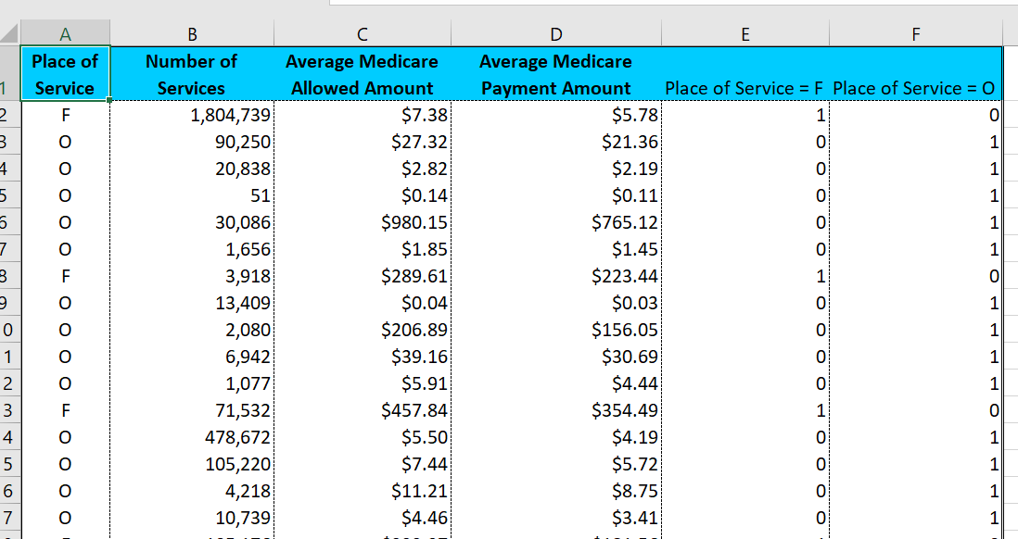
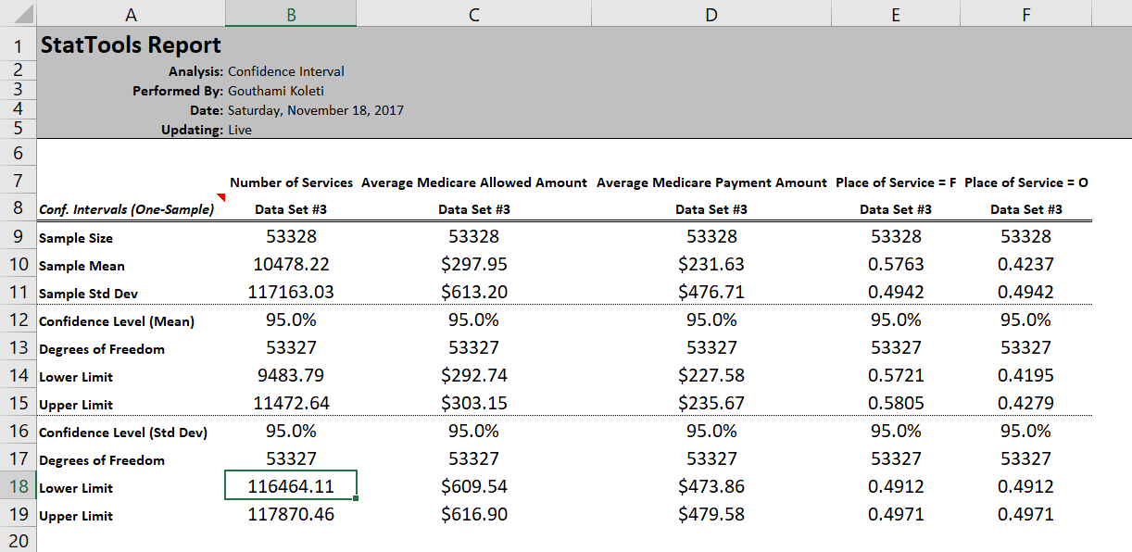
CONFIDENCE INTERVAL - PLACE AND NUMBER OF SERVICES
Medicare reimbursement to the providers is mainly based on the Place of service like Facility (F) and Non-Facility (O).
The following is the illustration supporting the inference.
Created Dummy variables for Categorical data of place of service.
Confidence interval showing the mean, standard deviation, upper limit and lower limit of each F and O services for 95% confidence intervals.
This clearly shows that the Medicare payment amount will be between range of $228 to $236 for every 42 to 43 services in place “O”.

Slide 33
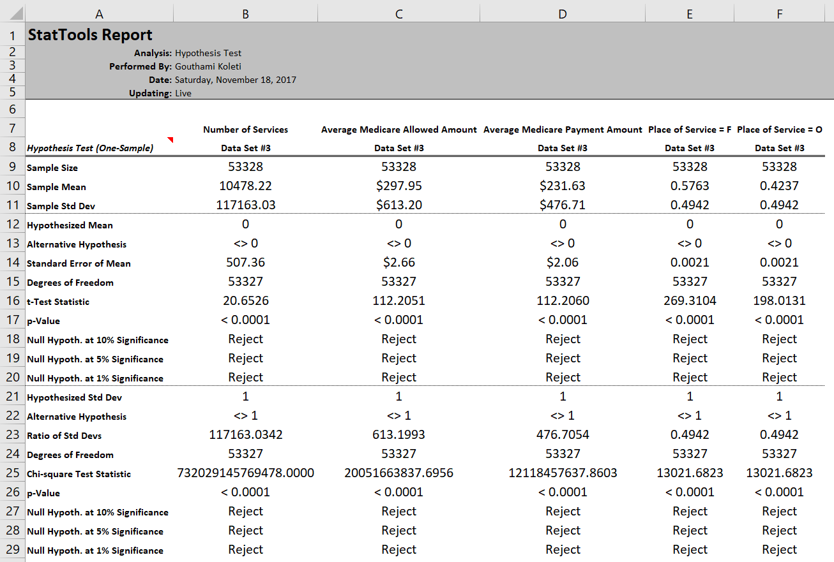
Hypothesis Test
Hypothesis test is done to show the if the proposed theory is right or not with the following conditions
Place of service is considered as Dependent Variable.
Number of services, Avg_medicare_Pymt_Amt, Avg medicare _ Allowed_Amt are considered as independent variables
Null Hypothesis – Medicare reimbursement have no influence of Place of service
Alternate Hypothesis- Medicare reimbursement have a significant impact on the place of service.
The test shows the P value is <0.0001 which is less than 0.005. Hence we reject Null Hypothesis and say Alternate Hypothesis is correct .

Slide 34
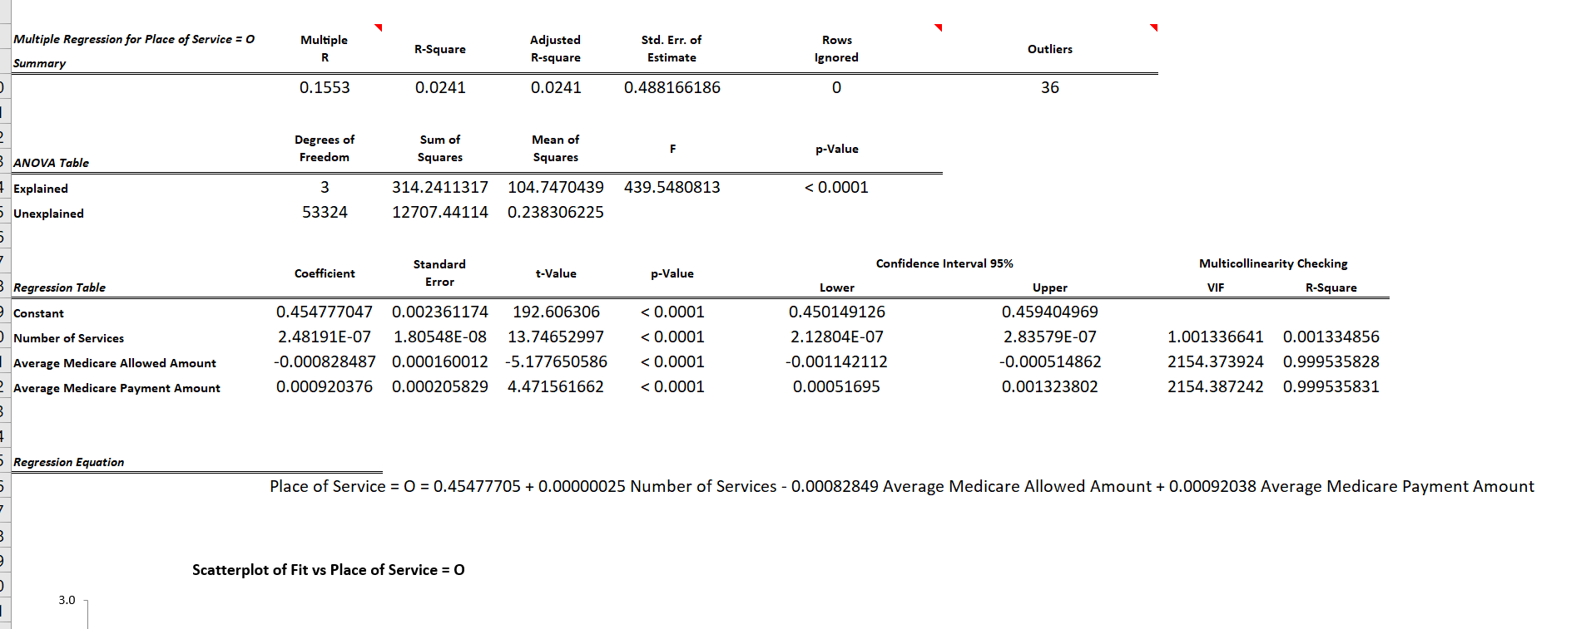
Regression Analysis
The formula in the graph showing the slope and independent variables

Slide 35
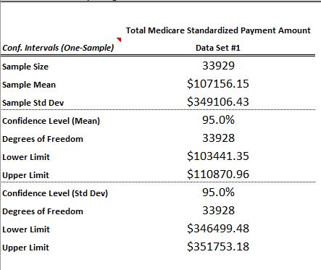
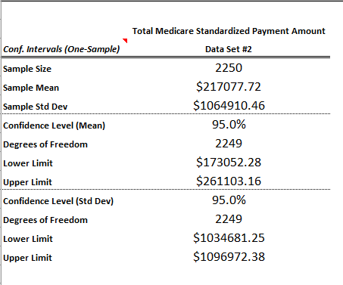
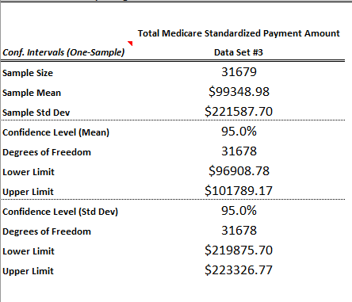
CONFIDENCE INTERVAL- PROVIDERS
All SE providers, confidence interval
ALL PROVIDERS
ONLY INDIVIDUAL
ONLY ORGANIZATION

